Slide 1
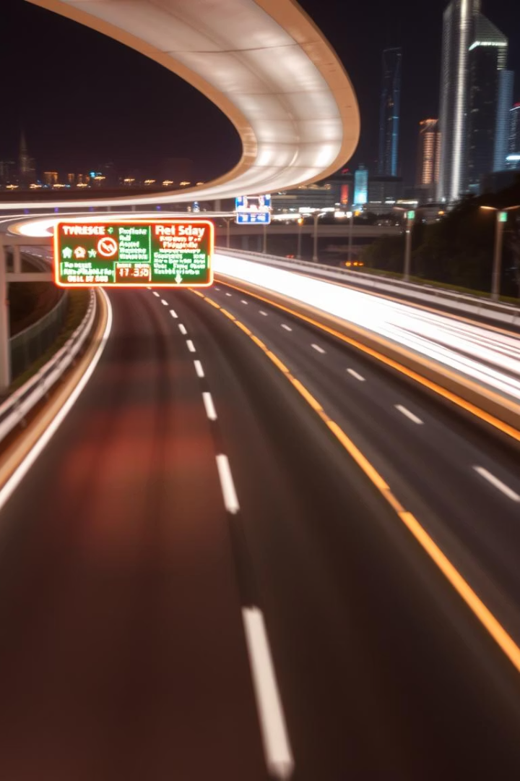
Road Sign Classification using Convolutional Neural Networks (CNN)
A Deep Learning-based Traffic Sign Recognition Project
Presented by: Hridhya Antony
Institution: KGiSL MicroCollege
Date:12 June 2025

Slide 2
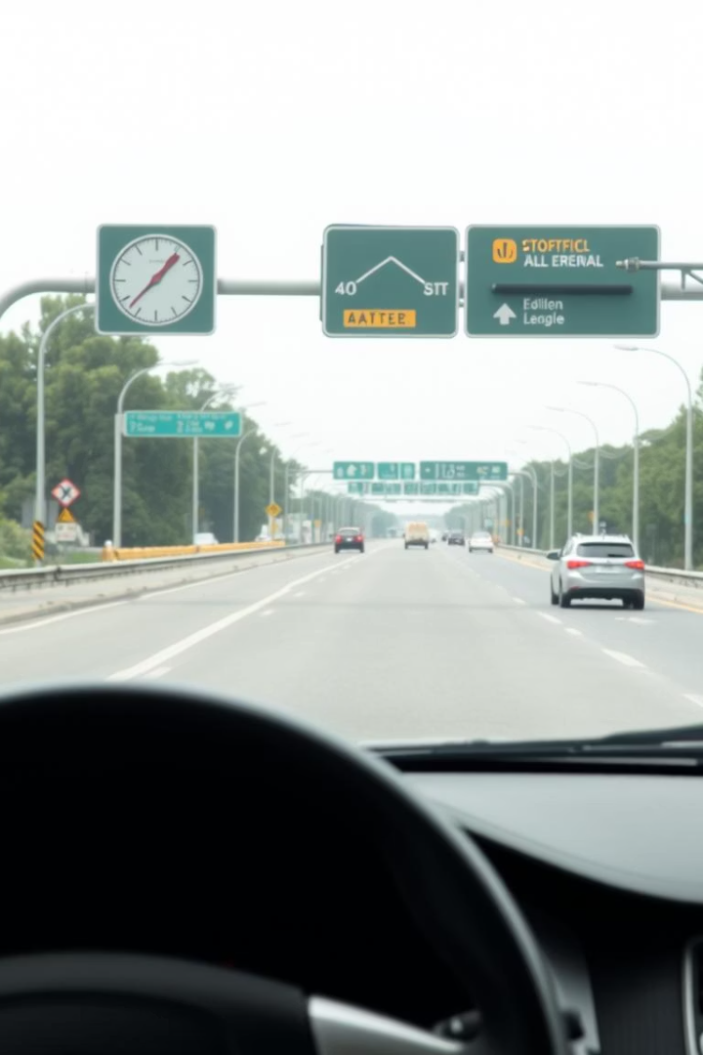
Objective
1
Classify Road Signs
Automatically identify road signs using image data.
2
Enhance Safety
Improve traffic system safety and automation.
3
Generalize Model
Build a deep learning model for unseen images.

Slide 3
Dataset Overview
Multi-Class Images
Data Augmentation
A large dataset of 50,000 road sign images is used. Each image is 32x32 pixels.
Rotation
Scaling
Classes include Speed Limit, Stop, Yield, and Pedestrian Crossing.
Brightness Adjustments

Slide 4

Methodology - CNN Architecture
Fully Connected Layers
Pooling Layers
Perform final classification based on features.
Convolutional Layers
Reduce dimensionality and computational load.
Extract features from image data.
The model uses ReLU activation and Adam optimizer for training, with categorical cross-entropy as the loss function.

Slide 5
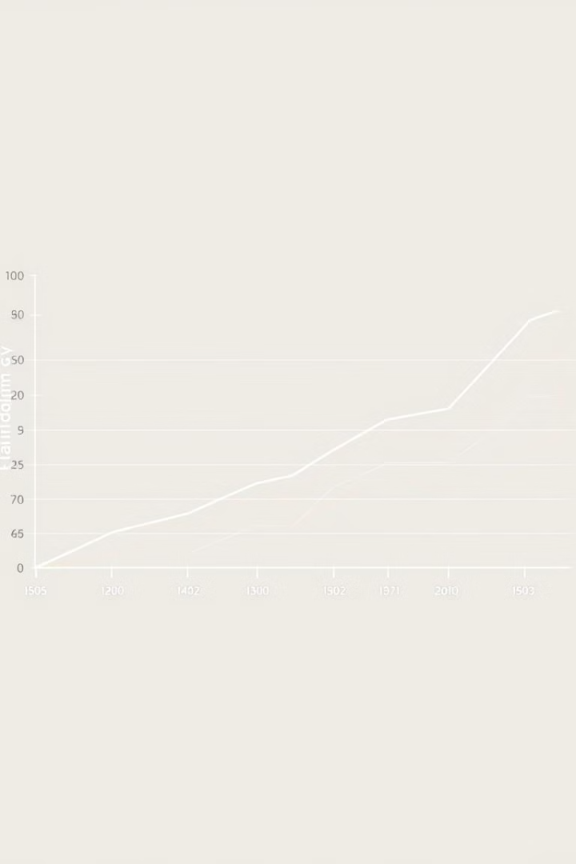
Methodology - Training
80%
20%
20
Training Data
Validation Data
Epochs
Used for model training.
For model evaluation.
Number of training cycles.
32
Batch Size
Samples processed per update.
Early stopping was implemented to prevent overfitting, ensuring robust model performance.

Slide 6
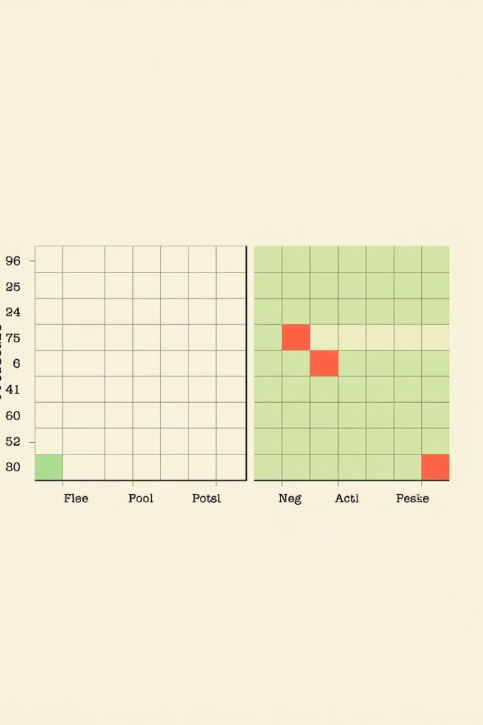
Results
98.5% Accuracy
Confusion Matrix
Achieved high accuracy on test data.
Detailed class-wise performance insight.
Misclassification Analysis
Identified and analyzed incorrect predictions.
Benchmarking shows strong performance compared to traditional image processing techniques. The model successfully generalizes to new images.

Slide 7





Challenges and Solutions
Limited Data
Varying Light
Occlusions
Reduced impact through augmentation.
Addressed with data augmentation.
Handled by augmentation.
Transfer Learning
Utilized pre-trained models like VGG16 and ResNet for improved performance.

Slide 8
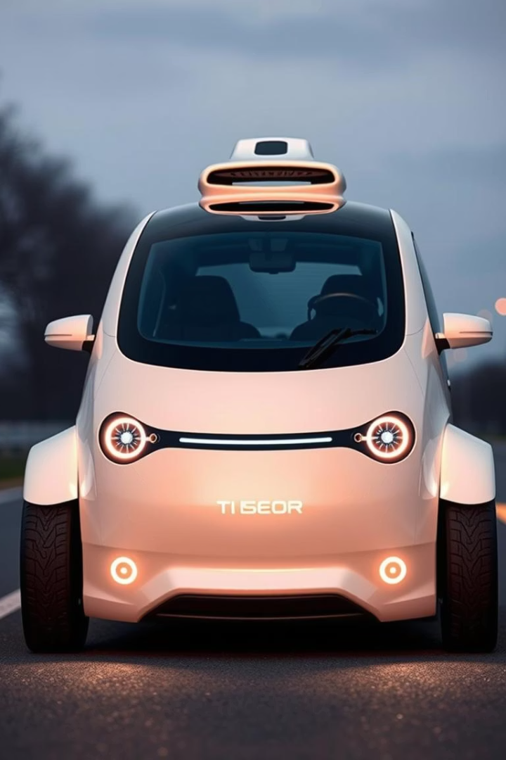
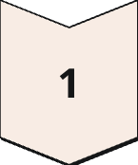
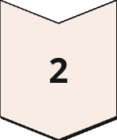
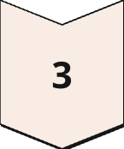
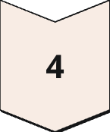
Conclusion and Future Work
CNNs Effective
Proven effective for road sign classification.
Real-time Systems
Implement for live traffic applications.
Advanced Architectures
Explore new CNN designs for higher accuracy.
Autonomous Vehicles
Integrate with self-driving car systems.

